Slide 1
EZ-IO® T.A.L.O.N.TM Tactically Advanced Lifesaving Intraosseous Needle
One Device, Seven Site System
Notes:
Thank you for taking the time to participate in the EZ-IO® T.A.L.O.N.TM 7-Site Intraosseous Vascular Access System training program. This program is designed to provide the practitioner with the didactic components for use of the EZ-IO T.A.L.O.N. System.
Indications & contraindications
Basic bone anatomy
Basic physiology
Identification of insertion landmarks
Insertion technique
Care and maintenance
Removal of the device and after care
This didactic component is not intended to constitute medical advice or direction. All procedures should be performed on the order, or under the direction, of a licensed physician or other qualified healthcare provider. This program is designed to be used in conjunction with hands-on practice with the EZ-IO T.A.L.O.N. System.
If at any time you have a question, please visit us online or call 866-479-8500.
Manufactured in the USA

Slide 2
TACTICAL ADVANTAGE
When rapid fluid or pharmacological resuscitation is required in emergency situations including (but not limited to):
Cardiac/Respiratory Arrest
Trauma
Shock
RSI
Anaphylaxis
Chemical exposure
MC-000302
Notes:
The EZ-IO® T.A.L.O.N.TM System is a silent manual intraosseous (IO) vascular access device indicated for adult patients when rapid fluid or pharmacological resuscitation is required in emergencies. It is designed for military and tactical medical team use only.
The EZ-IO T.A.L.O.N. System is cleared for use in 7 sites: the sternum and bilateral proximal humerus, proximal tibia, and distal tibia.

Slide 3
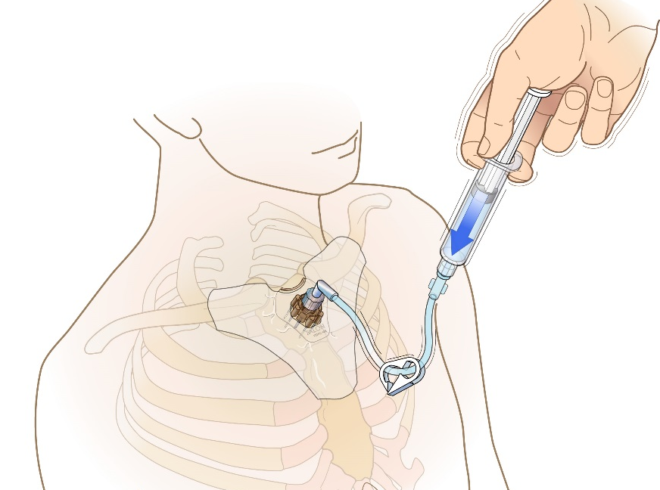
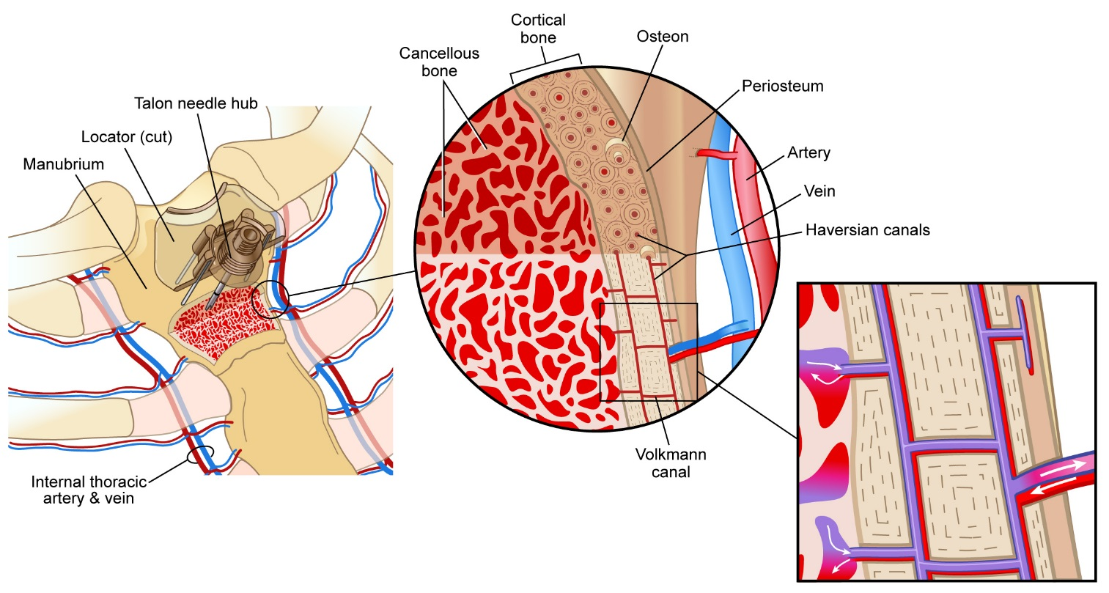
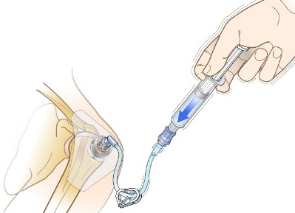
ANATOMY AND PHYSIOLOGY
Highly vascular, non-collapsible access
Rapid flush to displace marrow
Notes:
IO catheters are usually placed in the proximal and distal ends (epiphyses) of long bones due to the thinner compact bone and abundance of cancellous (spongy) bone at these sites; the sternum is a thin soft bone compared to most others. Within the medullary space lies a vast system of blood vessels through which blood and fluid pass into the central circulation. The bone is highly vascular, yet non-collapsible.
The cortex of the bone at insertion sites is usually 3 mm or less in thickness; 1-2 mm for the sternum. The EZ-IO® T.A.L.O.N.TM System is designed to provide rapid, smooth entry into the bone’s medullary cavity, creating a conduit to the central circulation. The needle tip is specially designed for cutting to allow clinicians control, with little use of force.
Think of the intraosseous space as a fine honeycomb of bone filled with fibrin mesh and bone marrow - a thick substance that poses more resistance to infusion than blood. A rapid flush is necessary to displace this thick substance and achieve optimal flow rates and drug delivery times using less pressure.

Slide 4
CONTRAINDICATIONS
Fracture of target bone
IO or attempted IO in the target bone within the previous 48 hours
Prosthesis or orthopedic procedure at insertion site
Infection at area of insertion
Inability to identify landmarks
Osteoporosis (sternal application only)
Notes:
There are few contraindications to IO access, and they are all relevant to site selection:
Trauma/Fracture (in the targeted bone) - If there is a fracture (or suspected fracture) in the bone in which the needle set is to be placed, an alternate site must be chosen. When an IO needle is placed in a fractured bone, fluid may leak or extravasate into the surrounding tissue through the fracture. This can lead to complications including compartment syndrome. If a tibial fracture is suspected, both the proximal and distal sites are contraindicated as they share a common pathway inside the bone. However, if the patient has a fractured femur and an intact tibia, the tibial sites could be considered – circulation from the lower leg should be assessed to determine the appropriateness of using the lower extremity for IO vascular access.
IO access within past 48 hours (targeted bone): Healing from intraosseous insertion generally takes approximately 48 hours and is required before another IO access can be safely placed in the same bone. Within 48 hours fibrin formation and clotting are sufficient to prevent extravasation through the previous IO access hole. If IO access was attempted in the bone, the same consideration applies. Complete healing, to the point where X-ray can no longer detect the hole, usually takes several days or weeks.¹
Prosthesis or previous orthopedic procedures near insertion site: If the patient has a surgical scar over a joint; assume there is a titanium appliance within the joint – and do NOT attempt IO vascular access at that site. Select a different insertion site and assess that site for use.
Infection at the insertion site: Do not insert the needle set through infected or inflamed tissue.
Inability to locate landmarks (e.g. due to excessive tissue): Inability to locate insertion site landmarks for any reason (including excess adipose tissues) is a contraindication - select an alternate insertion site where landmarks are identifiable.
Osteoporosis: Is a contraindication for the sternal site only
¹ Miller LJ, Philbeck TE, Puga TA, Montez DF, Escobar GP. A pre-clinical study to determine the time to bone sealing and healing following intraosseous vascular access. Ann Emerg Med 2011;58(4S):S240. Vidacare Sponsored Research

Slide 5
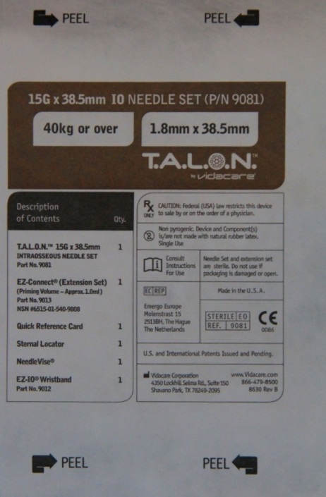
PACKAGE CONTENTS
Sternal Locator
15 gauge 38.5 mm manual IO needle set
EZ-Connect® Extension Set
Warning label
Sharps protector
Wristband
Quick Guide Reference Card
Notes:
The blister package is lightweight (1.4oz/39.7 grams), compact, latex free and contains the following items:
Quick Guide Reference Card - provides additional guidance for insertion as needed
Sternal Locator
EZ-IO® T.A.L.O.N.TM Needle Set: 15g, 304 stainless steel 38.5mm manual IO needle set – patented needle tip
A warning label on the needle set clarifies use/site indications
EZ-Connect® Extension Set with luer lock that will attach to the catheter hub.
Always prime the extension set with fluid before attaching to the catheter hub.
If the patient is unresponsive to pain, attach a saline flush to the extension set and prime the tubing with saline, leaving the syringe and remaining saline attached.
If the patient is responsive to pain, consider priming the extension set with 2% preservative-free lidocaine without epinephrine (intravenous lidocaine) for anesthesia prior to initial saline flush.
NeedleVISE® 1-Port Sharps Block - sharps protector
Wristband – with a place to write the date and time of IO insertion, 24 hour emergency clinical call number

Slide 6
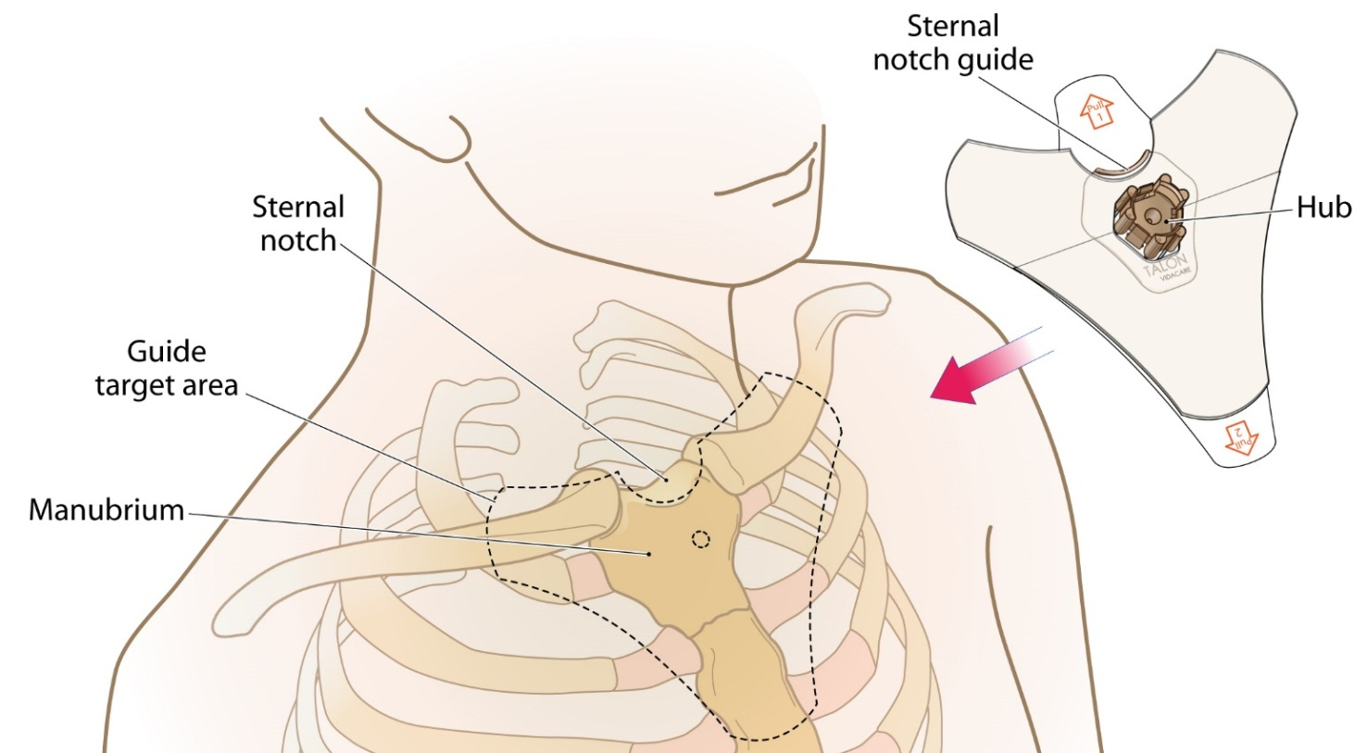
STERNAL SITE IDENTIFICATION
The Sternal Locator must be used when inserting the
EZ-IO® T.A.L.O.N™ Needle Set into the sternum
Sternal Locator
MC-000302
Notes:
The Sternal Locator MUST be used when inserting the needle set into the sternum. The Sternal Locator is designed to provide easy identification of the insertion site, safe insertion depth (preventing over penetration) and secure the catheter in place decreasing the risk of dislodgement. Check skin adipose and muscle thickness before insertion. Special caution must be exercised with patients with BMI greater than 30.
PROCEDURE
Utilize appropriate Body Substance Isolation Precautions, use a clean, “no touch” technique, maintaining asepsis.
Prepare infusion system/prime EZ-Connect® Extension Set.
Prepare insertion site.
Locate the sternal notch by palpation. Note that the manubrium lies below the sternal notch. Remove sternal locator dressing cap and pull tab 1.
Align curve (sternal notch guide) on top of the Sternal Locator with the patient’s sternal notch.
Press the hub firmly and evenly downward into the patient. The six probe tips should penetrate the skin and rest firmly on the manubrial surface; probes should NOT penetrate the cortex of the bone.
Remove tab 2 and secure the adhesive to the skin.

Slide 7
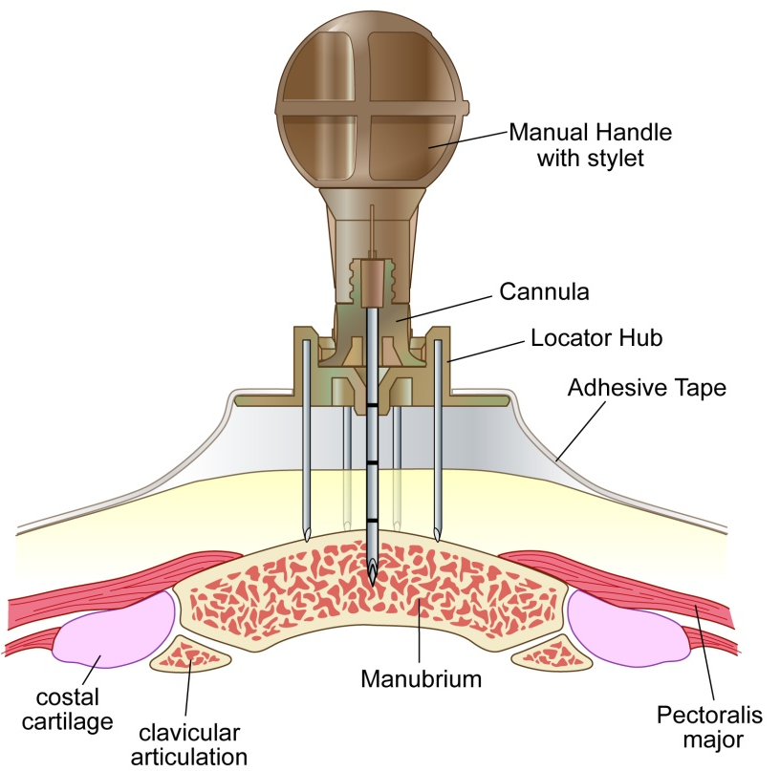
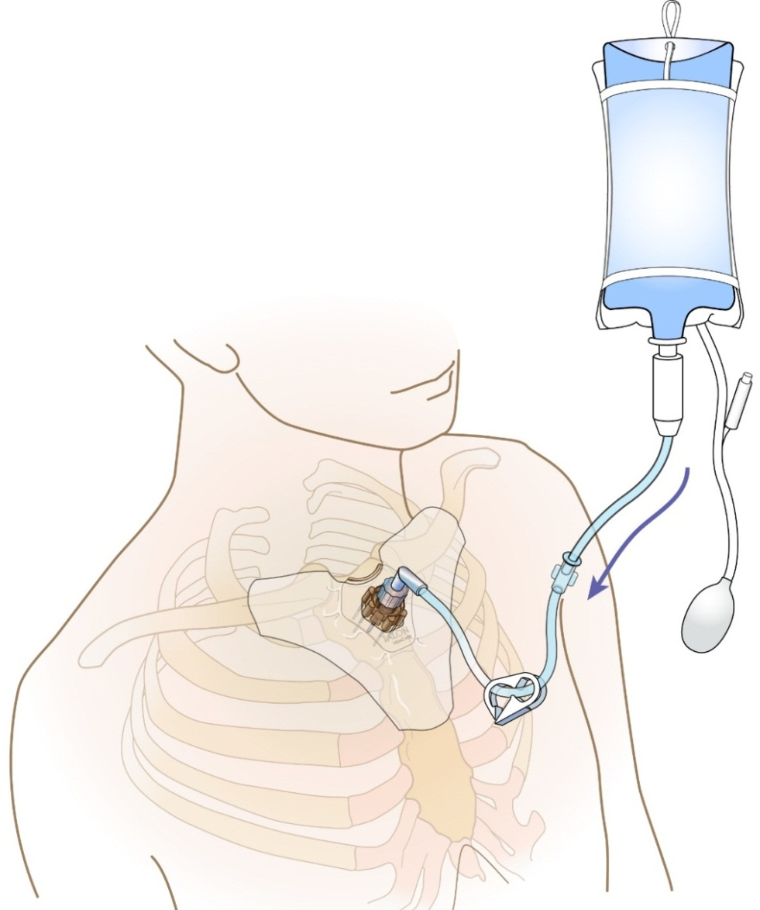
STERNAL SITE TECHNIQUE
Notes:
PROCEDURE (cont.)
With the needle set tip at a 90 degree angle to the bone, place the tip into the hole in the center of the sternal locator dressing.
Gently insert until the tip of the needle set touches bone.
Penetrate the bone cortex by rotating clockwise while applying gentle, steady downward pressure (10-15 lbs / 5-7 kg). The handle on the stylet is designed to utilize the fingers for better tactile feedback and prevent excessive pressure.
Do not rock or bend during insertion.
Maintain a 90 degree angle to the bone.
Stop the insertion process upon entry into the medullary space and as indicated when a click is felt or heard as the needle set locks into the sternal locator dressing The needle set MUST lock into the sternal locator dressing to prevent movement and reduce the risk of dislodgement.
Hold the hub of the needle set and twist the handle counter clockwise to remove the stylet.
The needle should feel firmly seated in the bone (1st confirmation of placement).
Place stylet in a sharps container.
Dispose of all sharps and biohazard materials using standard biohazard practices and disposal containers. If using the NeedleVISE® 1-Port Sharps block, place on stable surface and use a one-handed technique.
Attach the primed extension set to the catheter hub and twist clockwise to secure.
Aspirate for blood/bone marrow (2nd confirmation of placement)*
*Inability to withdraw blood from the catheter does not mean the insertion was unsuccessful. Consider attempting to aspirate after the flush. Site placement can also be confirmed by ability to administer pressurized fluids, and noting the pharmacologic effects of medication administration after flow is established.

Slide 8
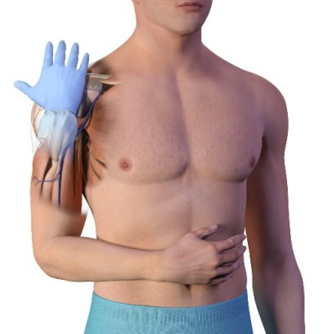
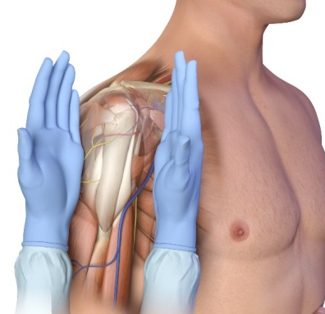
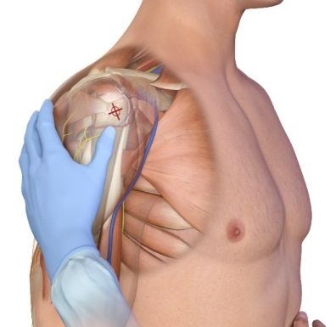
PROXIMAL HUMERUS SITE IDENTIFICATION
Notes:
There are several advantages to using the proximal humerus insertion site. The proximity of the greater tubercle of the humerus to the heart ensures rapid infusion of medications into the central circulation. Flow rates averaging 5L per hour can be achieved using the humeral site.¹ Medications and fluids reach the right atrium in 3 seconds.² Research reports insertion into the proximal humerus results in lower insertion and infusion pain than the tibia and requires less medication for pain management. ¹
Utilize appropriate Body Substance Isolation Precautions, use a clean, “no touch” technique, maintaining asepsis.
Identify and prepare insertion site and supplies.
Identify the proximal humerus:
Place the patient’s hand over the abdomen (elbow adducted and humerus internally rotated)
Place your palm on the patient’s shoulder anteriorly. The area that feels like a “ball” under your palm is the general target area. You should be able to feel this ball, even on obese patients, by pushing deeply.
Place the ulnar aspect of one hand vertically over the axilla
Place the ulnar aspect of the opposite hand along the midline of the upper arm laterally
Place your thumbs together over the arm - this identifies the vertical line of insertion on the proximal humerus
Palpate deeply up the humerus to the surgical neck - it will feel like a golf ball on a tee – the spot where the “ball” meets the “tee” is the surgical neck
The insertion site is on the most prominent aspect of the greater tubercle, 1 to 2 cm above the surgical neck
¹ Philbeck TE, Miller LJ, Montez D, Puga T. Hurt so good; easing IO pain and pressure. JEMS 2010;35(9):58-69 (Research sponsored by Vidacare Corporation)
² Data on file. 2013 Vidacare Internal Studies.

Slide 9
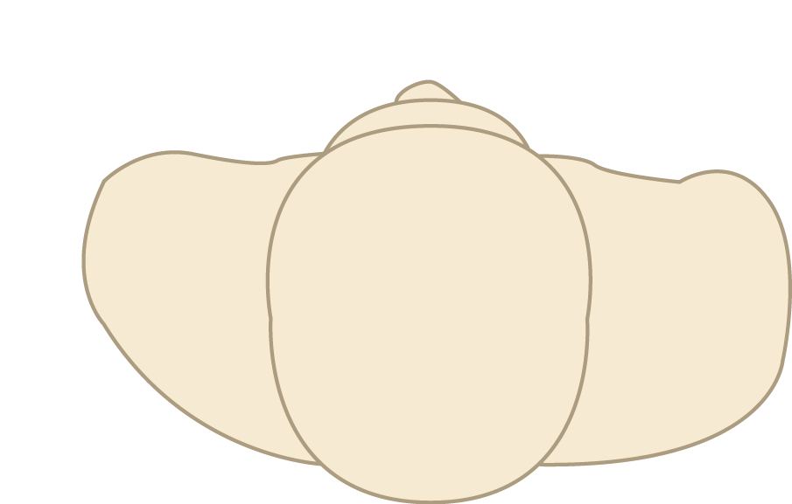
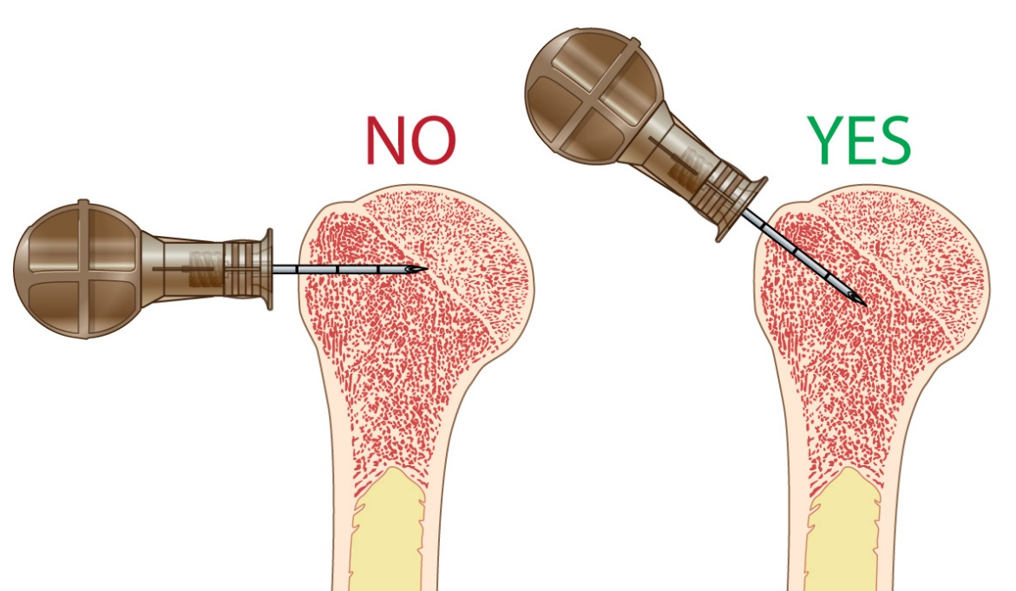
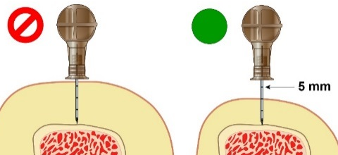
PROXIMAL HUMERUS INSERTION
Aim needle tip at a 45 degree angle to the anterior plane and posteromedial
Anterior Plane
45^{O}
Ensure adequate needle length
Notes:
Proximal Humerus Insertion Angle
Insertion angle is important, to ensure placement that will provide optimal vascular access.
For the proximal humerus insertion, aim the needle set tip at a 45-degree angle to the anterior plane and posteromedial.
Adult Proximal Humerus Insertion Technique
Stabilize the extremity.
Push the T.A.L.O.N.™ Needle Set tip through the skin until the tip rests against the bone.
The 5 mm mark must be visible above the skin for confirmation of adequate needle length.
Penetrate bone cortex with steady, firm pressure, maintaining correct angle.
Do NOT use excessive force. Do NOT rock or bend needle set during insertion. Maintain 45-degree angle to the horizontal (anterior) plane.
Catheter tip rotation (clockwise) provides penetrating action.
Stop insertion process when desired depth is obtained or catheter hub is flush with the skin.
Insertion time varies as bone density varies from patient to patient.
Hold the needle set hub while twisting the stylet off the hub with counter clockwise rotations.
The needle should feel firmly seated in the bone (1st confirmation of placement).
Place the stylet in sharps container.
Always dispose of all sharps and biohazard materials from intraosseous lines using standard biohazard practices and disposal containers. If using the NeedleVISE® 1 Port Sharps Block, place on stable surface and use a one-handed technique.
Place an EZ-Stabilizer® Dressing over the catheter hub. (The EZ-Stabilizer Dressing is sold separately and not packaged with the EZ-IO® TALON™ System.)
Attach the primed extension set.
Remove EZ-Stabilizer Dressing tabs to expose adhesive and apply to skin.
Aspirate for blood/bone marrow (2nd confirmation of placement)*
*Absence of blood or inability to withdraw aspirate at the catheter hub does not mean the insertion was unsuccessful. Site placement can also be confirmed by ability to administer pressurized fluids, and noting the pharmacologic effects of medication administration after flow is established.

Slide 10
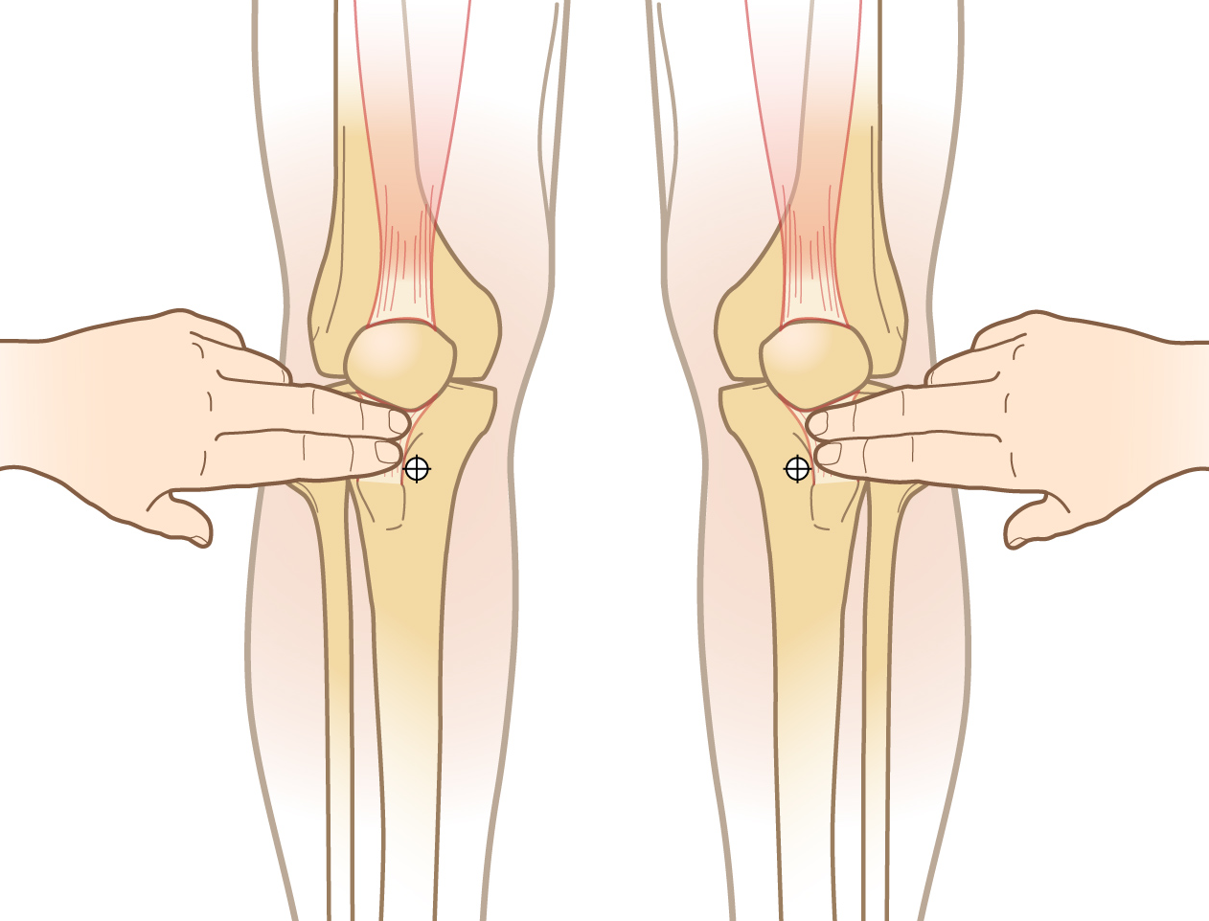
PROXIMAL TIBIA SITE IDENTIFICATION (ADULT)
Approximately 3 cm below the patella and 2 cm medial
Notes:
Utilize appropriate Body Substance Isolation Precautions, use a clean, “no touch” technique, maintaining asepsis.
Identify and prepare insertion site and supplies.
Adult proximal tibia site identification – Extend leg. Insertion site is approximately 3 cm (two finger widths) below the patella and approximately 2 cm medial, along the flat aspect of the tibia.

Slide 11
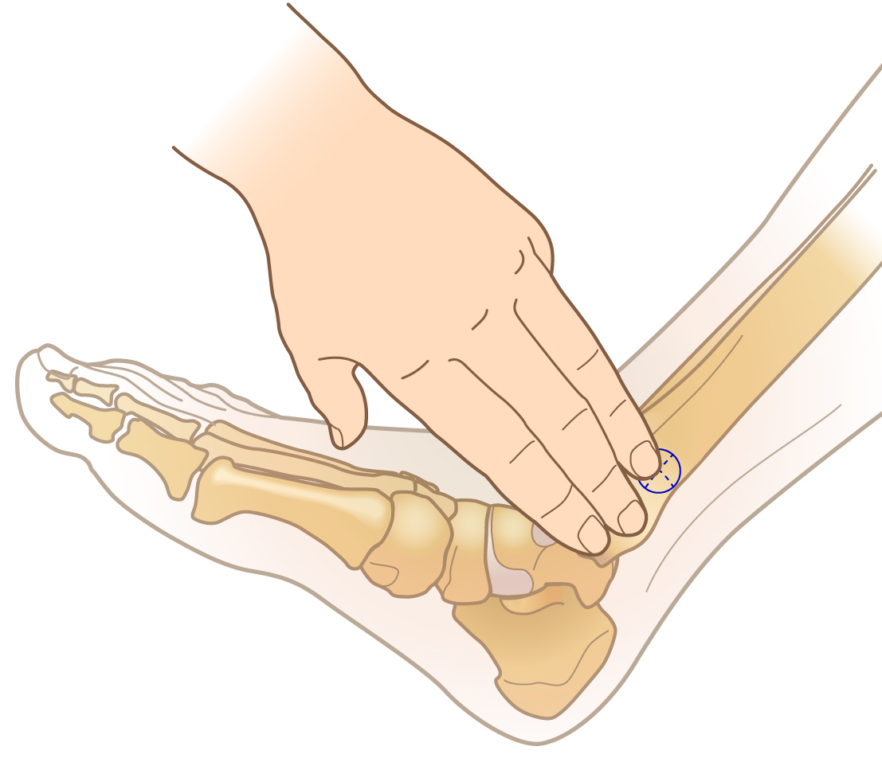
DISTAL TIBIA SITE IDENTIFICATION (ADULT)
Approximately 3 cm proximal to the most prominent aspect of the medial malleolus, on the flat center aspect of the bone
Notes:
Take appropriate Body Substance Isolation Precautions, use a clean, “no touch” technique, maintaining asepsis.
Identify and prepare insertion site and supplies.
Adult distal tibia insertion site is located approximately 3 cm (2 finger widths) proximal to the most prominent aspect of the medial malleolus. Palpate the anterior and posterior borders of the tibia to assure that your insertion site is on the flat center aspect of the bone.

Slide 12
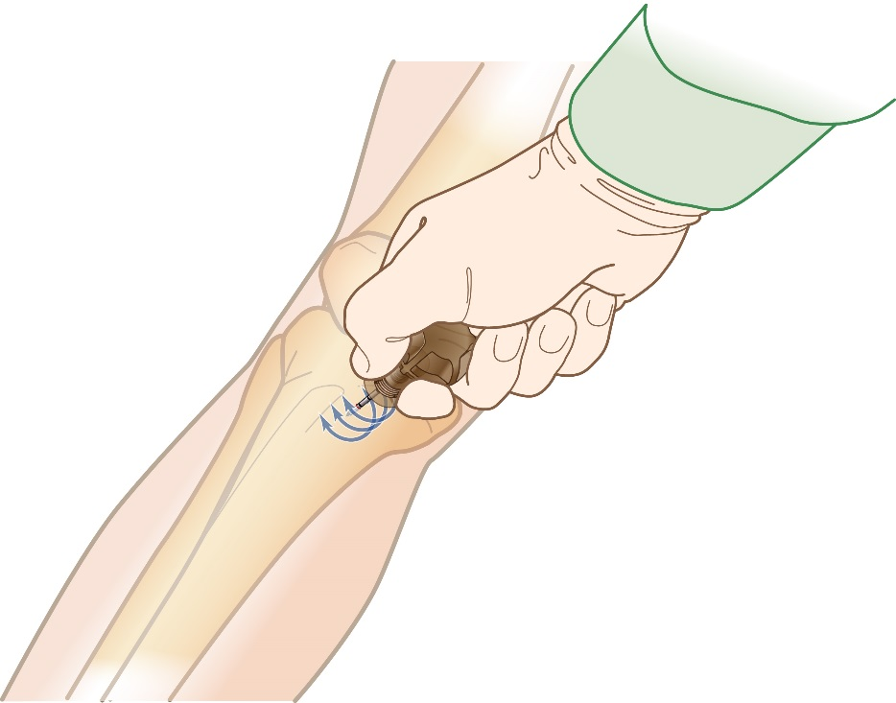
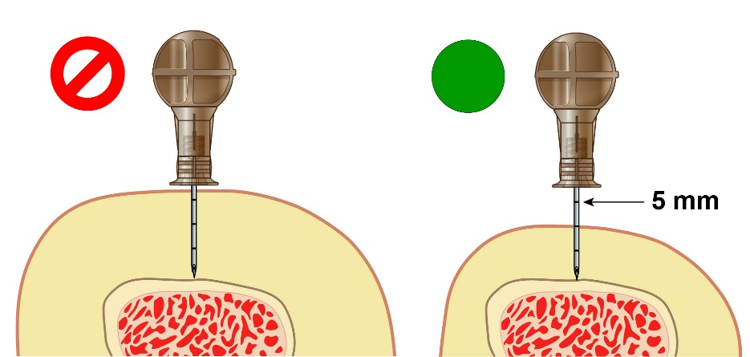
TIBIA INSERTION TECHNIQUE
Insert needle at a 90 degree angle to the bone
Ensure adequate needle length
Notes:
Tibial Insertion Angle
Insert needle set at a 90-degree angle to the bone for tibial insertions.
TIBIA INSERTION TECHNIQUE
Stabilize the extremity.
Push the EZ-IO® T.A.L.O.N.TM Needle Set tip through the skin until the tip rests against the bone.
The 5 mm mark must be visible above the skin for confirmation of adequate needle length.
Penetrate bone cortex with steady, firm pressure, maintaining correct angle.
Do NOT use excessive force. Do NOT rock or bend needle set during insertion.
Maintain 90-degree angle to the bone.
Catheter tip rotation (clockwise) provides penetrating action.
Stop insertion process when desired depth is obtained or catheter hub is flush with the skin.
Insertion time varies as bone density varies from patient to patient.
Hold the needle set hub while twisting the stylet off the hub with counter clockwise rotations.
The needle should feel firmly seated in the bone (1st confirmation of placement).
Place the stylet in sharps container.
Always dispose of all sharps and biohazard materials from intraosseous lines using standard biohazard practices and disposal containers. If using the NeedleVISE® 1 Port Sharps Block, place on stable surface and use a one-handed technique.
Place an EZ-Stabilizer® Dressing over the catheter hub. (The EZ-Stabilizer Dressing is sold separately and not packaged with the EZ-IO® TALON™ System.)
Attach the primed extension set.
Remove EZ-Stabilizer Dressing tabs to expose adhesive and apply to skin.
Aspirate for blood/bone marrow (2nd confirmation of placement)*
*Absence of blood or inability to withdraw aspirate at the catheter hub does not mean the insertion was unsuccessful. Site placement can also be confirmed by ability to administer pressurized fluids, and noting the pharmacologic effects of medication administration after flow is established.

Slide 13
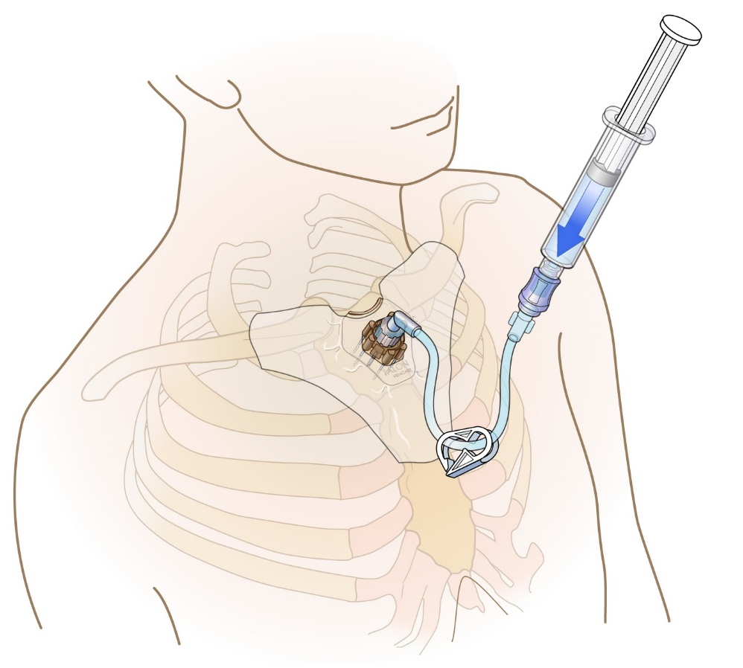
RAPID FLUSH
Adults: 5-10 mL Normal Saline
Consider for blood typing and other commonly ordered labs
Notes:
Flush
It is essential to perform a rapid Normal Saline (NS) syringe flush into the IO space before attempting to infuse fluids or medications. A rapid syringe flush of 5-10 mL normal saline in adults helps clear the marrow and fibrin from the medullary space, allowing for effective infusion rates. IO access may be compromised if the line is not used for prolonged periods. IO lines can often be opened successfully by an additional syringe flush. As with an IV infusion, an IO line should be assessed for patency and flushed before and after infusion. It is important to avoid extreme pressure for the flush, which may increase the risk of extravasation.
Labs
Based on preclinical and clinical evidence comparing IO and venous or arterial sources a number of common laboratory values correlate well; other values show clinical similarity without statistically significant correlation, therefore caution should be exercised with their interpretation. Certain point of care analyzers have been studied with acceptable results. Check with your laboratory for IO specimen processing capabilities. For more information regarding IO lab analysis, refer to the publication Science and Fundamentals of Intraosseous Vascular Access, available at: www.teleflex.com/ezioeducation
The following recommendations have been developed based on research done by Teleflex Incorporated (Vidacare LLC); study data was based on IO blood specimens obtained prior to any infusions or flush:
Connect a syringe directly to the EZ-IO® Catheter hub.
The first 2 mL of IO blood aspirate may be discarded or considered for point of care testing.
Samples must be identified as IO blood

Slide 14
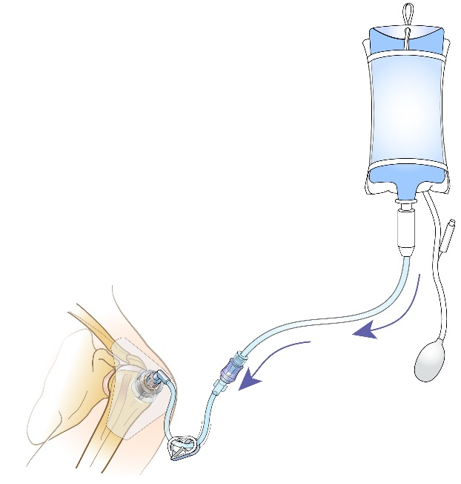
INFUSION AND MEDICATIONS
For optimal flow infuse with pressure
Administer medications in same dose, rate and concentration as given via peripheral IV
Notes:
Infusions
As with other vascular access lines, IO flow rates will vary among patients and anatomical sites. Generally, adequate flow rates are dependent on performing a rapid flush (syringe bolus) prior to IO infusion and infusing fluids and medications under pressure (e.g. infusion pressure pump or pressure bag). Gravity alone will rarely generate adequate flow rates; the higher the pressure, the faster the flow. Generally, the sternum and proximal humerus allows higher flow rates than the tibial sites.
The intraosseous resistance in the medullary space is a fraction of the patient’s mean arterial pressure. This is important to remember - fluids or medications must be delivered under pressure to obtain maximum flow rates.
Infusion pressure is the rate-limiting factor in achieving adequate flow rates in IO infusions; the higher the pressure, the greater the flow rate. Many infusion pumps (including rapid infusers such as the Level 1® ) are designed to administer large amounts of fluid very rapidly, but often work by measuring volume rather than infusion pressure. If adequate IO flow rates cannot be achieved with an infusion pump, a pressure bag should be considered. Many infusion pumps and rapid infusers will alarm if the pressure inside the IO space exceeds 300 mmHg. If this happens, deliver infusion at a slower rate.
Medications
Virtually any medication that can be given via a peripheral IV can be given IO using the same dose, rate and concentration.¹⁻⁴ Verify placement/patency prior to all infusions. Follow medication administration with a flush. Use caution when infusing hypertonic solutions, chemotherapeutic agents, or vesicant drugs.
¹ Von Hoff DD , Kuhn JG, Burris HA, Miller LJ. Does intraosseous equal intravenous? A pharmacokinetic study. Amer J Emerg Med 2008;26:31-8.
² Hoskins SL, Kramer GC , Stephens CT, Zachariah BS. Efficacy of epinephrine delivery via the intraosseous humeral head route during CPR. Circulation 2006;114:II_1204.
³ Hoskins S, Nascimento P, Espana J, Kramer G. Pharmacokinetics of intraosseous drug delivery during CPR. Shock 2005;23:35.
⁴ Hoskins SL, Nascimento P Jr., Lima RM, Espana-Tenorio, JM, Kramer GC . Pharmacokinetics of intraosseous and central venous drug delivery during cardiopulmonary resuscitation. Resuscitation 2012;83(1):107-12. Vidacare Sponsored Research

Slide 15
RECOMMENDED ANESTHETIC TECHNIQUE FOR ADULTS
Prime extension set with 2% lidocaine (IV lidocaine)
Slowly infuse 2% lidocaine 40 mg over 120 seconds
Allow lidocaine to dwell in IO space 60 seconds
Flush with normal saline
Slowly infuse 2% lidocaine 20 mg over 60 seconds
Observe cautions/contraindications for lidocaine, confirm dose per institution
Notes:
For patients able to perceive pain, there can be significant discomfort associated with the initial flush as well as infusion. Pressure changes occur within the bone as a result of infusion of medications and fluids, and if not properly anesthetized, pain associated with IO infusion under pressure is often severe. Anesthetizing the IO space prior to the initial flush should be considered for any patient that is conscious/alert to pain. If time constraints do not permit anesthetization prior to the initial flush, pain management should be considered as soon as time permits, and as needed throughout the course of IO infusion. This recommended anesthetic technique for administration of lidocaine is specific and based on research (data on file).
Recommended anesthetic for adult patients responsive to pain:
Observe recommended cautions/contraindications to using 2% preservative and epinephrine free lidocaine (intravenous lidocaine)
Confirm lidocaine dose per institutional protocol
Prime EZ-Connect® Extension Set with lidocaine Note that the priming volume of the EZ-Connect® Extension Set is approximately 1.0 mL
Slowly infuse lidocaine 40 mg IO over 120 seconds
Allow lidocaine to dwell in IO space 60 seconds
Flush with 5 to 10 mL of normal saline
Slowly administer an additional 20 mg of lidocaine IO over 60 seconds
Repeat PRN
Consider systemic pain control for patients not responding to IO lidocaine
The use of any medication, including lidocaine, given IV or IO is the responsibility of the treating physician, medical director or qualified prescriber and not an official recommendation of Teleflex Incorporated or its subsidiaries. Teleflex is not the manufacturer of lidocaine, and the user should be familiar with the manufacturer’s instructions or directions for use for all indications, side-effects, contraindications, precautions and warnings of lidocaine. Teleflex disclaims all liability for the use, application or interpretation of the use of this information in the medical treatment of any patient.

Slide 16
ASSESSMENT
Site/Catheter
Intact/patent
Dressing and connections are secure
Need for repeat flush
Evidence of complications
Pain assessment
Need for additional lidocaine
Notes:
Care and maintenance of the IO catheter is similar to other venous access routes: ensure the site is intact and catheter is securely in place, dressing is intact and connections are secure. Confirm placement prior to medication and fluid administration. Repeat a rapid normal saline flush as needed. Monitor frequently for evidence of complications.
Extravasation is the most common complication associated with IO insertion, and can lead to serious complications such as compartment syndrome and necrosis. The insertion site and posterior compartments (depending on insertion site) should be monitored frequently for any signs of extravasation, localized inflammation, limb perfusion or dislodgement particularly in the first half hour after insertion and anytime the IO catheter is manipulated.
Assess patient comfort and manage infusion related pain.
The IO catheter may remain in place up to 24 hours.
Consider adding an IO documentation template to your computer charting.

Slide 17
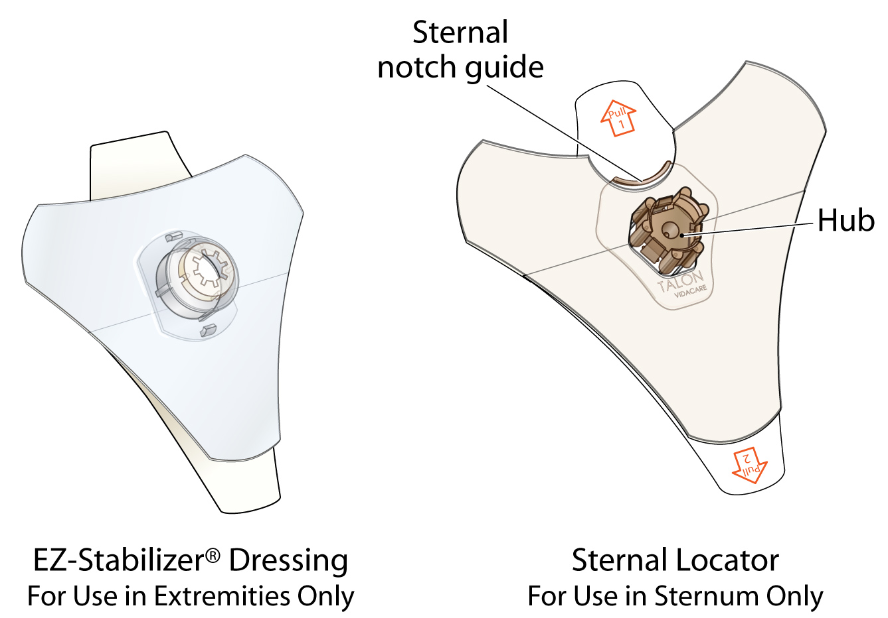
Sternal Locator vs. EZ-Stabilizer® Dressing
Notes:
The Sternal Locator is a component of the EZ-IO® T.A.L.O.N.TM package contents and must be used with all sternal insertions. The Sternal Locator is designed to provide easy identification of the insertion site. The Sternal Locator facilitates safe insertion depth, preventing over penetration. The needle set snaps into the Sternal Locator providing an audible and tactile indication of insertion completion. Additionally, the Sternal Locator helps secure the device, decreasing the risk of dislodgement.
The EZ-Stabilizer® Dressing is sold separately, it is NOT packaged with the EZ-IO® T.A.L.O.N.TM System. The EZ-Stabilizer Dressing is for use in extremities only, and is strongly recommended to help prevent dislodgement of the catheter inserted in the proximal humerus, proximal tibia or distal tibia.
The products are NOT interchangeable.

Slide 18
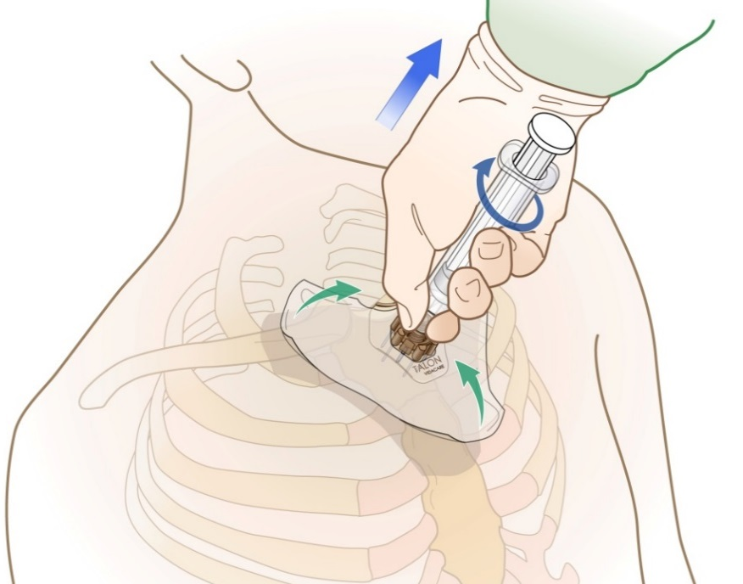
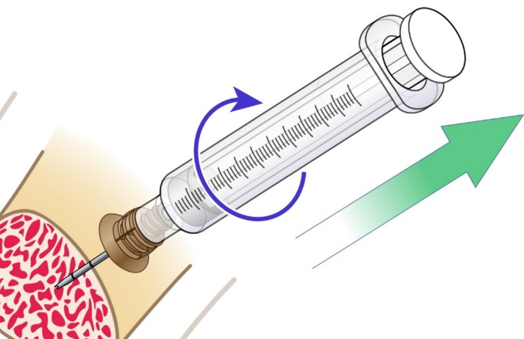
REMOVAL
Do NOT rock or bend during removal
Notes:
Removal is simple and does not require any specialized tools.
STERNAL Removal
Remove the extension set.
Attach a luer lock syringe to the catheter hub.
Loosen the adhesive tabs on the sternal locator dressing.
Using the syringe as a handle, rotate clockwise and pull catheter and sternal locator dressing straight up and out in one swift pulling motion.
Do not rock or bend during removal
HUMERUS or TIBIA Removal
Remove the extension set and dressing
Attach a luer lock syringe to the catheter hub
Stabilize the extremity
Using the syringe as a handle, rotate syringe and catheter clockwise while pulling straight out
Do not rock or bend during removal.
Always dispose of all sharps and biohazard materials using standard biohazard practices and disposal containers.
Apply pressure as needed. Dress site as appropriate.
There are no activity restrictions after the catheter is removed.
The patient should be directed to seek medical care if they experience signs and symptoms of infection, pain near the insertion site or any other unusual symptoms.

Slide 19
24 Hour Clinical Support 800-680-4911
Teleflex, EZ-IO. EZ-Connect, EZ-Stabilizer and T.A.L.O.N. are trademarks or registered trademarks of Teleflex Incorporated or its affiliates.
© 2014 Teleflex Incorporated. All rights reserved. MC-000302
Notes:
We are happy to provide 24 hour clinical support: 800-680-4911. This number can also be found on the patient wristband and our website: www.teleflex/military
We place tremendous value on direct clinical feedback, so we invite you to visit our website to gain the newest, cutting edge product information and to provide us with your direct feedback on our product’s performance.
Consult Instructions for Use (IFU) prior to use of this product.
This material is not intended to replace standard clinical education and training by Teleflex Incorporated and its subsidiaries and should be utilized as an adjunct to more detailed information which is available about the proper use of the product. View educational resources at www.teleflex.com/ezioeducation or contact a Teleflex clinical professional for any detailed questions related to product insertion, maintenance, removal and other clinical education information.

