Slide 1
IO Infusion Pain Management
Arrow® EZ-IO® Intraosseous Vascular Access System

Slide 2
IO Infusion Pain Management
Overview:
For patients able to perceive pain, there can be significant discomfort associated with the initial flush as well as the infusion process. Pressure changes occur within the bone as a result of infusion of medications and fluids. Infusion pain may be minimized with correct administration of 2% preservative-free and epinephrine-free lidocaine (intravenous lidocaine) in accordance with hospital protocols and policies.^{1,2}
Anesthetizing the intraosseous (IO) space prior to the initial flush should be considered by a qualified healthcare provider for any patient who is conscious/alert to pain^{1,2}. If time constraints do not permit anesthetization prior to the initial flush, pain management should be considered as necessary.
DISCLAIMER: Selection and use of any medication, including lidocaine, given IV or IO is the responsibility of the treating physician, medical director, or qualified prescriber and is not an official recommendation of Teleflex Incorporated. The information provided is a summary of information found in the cited reference materials. This information is not intended to be a substitute for sound clinical judgment or your institution’s treatment protocols. Teleflex Incorporated is not the manufacturer of lidocaine. Users should review the manufacturer's instructions or directions for use and be familiar with all indications, side effects, contraindications, precautions and warnings prior to administration of lidocaine or any other medication. Teleflex Incorporated disclaims all liability for the application or interpretation of this information in the medical treatment of any patient. Any health care provider using this material assumes full responsibility for the medical care and treatment of their patients. For additional information please visit www.eziocomfort.com.
1. Paxton JH, Knuth TE, Klausner HA. Proximal humerus intraosseous infusion: a preferred emergency venous access. J Trauma. 2009;67(3):1-7. Research sponsored by Teleflex Incorporated.
2. Davidoff J, Fowler R, Gordon D, Klein G, Kovar J, Lozano M, Potkya J, Racht E, Saussy J, Swanson E, Yamada R, Miller L. Clinical evaluation of a novel intraosseous device for adults: prospective, 250-patient, multi-center trial. JEMS 2005;30(10):s20-3. Research sponsored by Teleflex Incorporated.

Slide 3
IO Infusion Pain Management
DISCLAIMER: Observe cautions/contraindications for lidocaine, confirm dose per institution. Selection and use of any medication, including lidocaine, given IV or IO is the responsibility of the treating physician, medical director, or qualified prescriber and is not an official recommendation of Teleflex Incorporated. The information provided is a summary of information found in the cited reference materials. This information is not intended to be a substitute for sound clinical judgment or your institution’s treatment protocols. Teleflex Incorporated is not the manufacturer of lidocaine. Users should review the manufacturer's instructions or directions for use and be familiar with all indications, side effects, contraindications, precautions and warnings prior to administration of lidocaine or any other medication. Teleflex Incorporated disclaims all liability for the application or interpretation of this information in the medical treatment of any patient. Any health care provider using this material assumes full responsibility for the medical care and treatment of their patients.
For additional information please visit www.eziocomfort.com.
IO Infusion Pain Management

Slide 4
IO Infusion Pain Management Using 2% Lidocaine
(preservative-free and epinephrine-free)
Review lidocaine manufacturer’s IFU prior to administration and observe recommended cautions/contraindications.
With the stabilizer in place, carefully attach syringe directly to IO catheter luer-lock hub, without extension set in place.
Slowly infuse initial dose of lidocaine over 120 seconds and allow to dwell for 60 seconds
Adult: initial dose 40 mg
Infant/Child: initial dose 0.5mg/kg (NOT to exceed 40 mg)
Flush IO catheter with normal saline
Adult flush: 5-10 mL
Infant/Child flush: 2-5 mL
Slowly infuse lidocaine (half of initial dose) over 60 seconds
Attach extension set primed with normal saline and flush
Repeat PRN. Consider systemic pain control for patients not responding to IO lidocaine.
DISCLAIMER: Observe cautions/contraindications for lidocaine, confirm dose per institution. Selection and use of any medication, including lidocaine, given IV or IO is the responsibility of the treating physician, medical director, or qualified prescriber and is not an official recommendation of Teleflex Incorporated. The information provided is a summary of information found in the cited reference materials. This information is not intended to be a substitute for sound clinical judgment or your institution’s treatment protocols. Teleflex Incorporated is not the manufacturer of lidocaine. Users should review the manufacturer's instructions or directions for use and be familiar with all indications, side effects, contraindications, precautions and warnings prior to administration of lidocaine or any other medication. Teleflex Incorporated disclaims all liability for the application or interpretation of this information in the medical treatment of any patient. Any health care provider using this material assumes full responsibility for the medical care and treatment of their patients.
For additional information please visit www.eziocomfort.com.

Slide 5
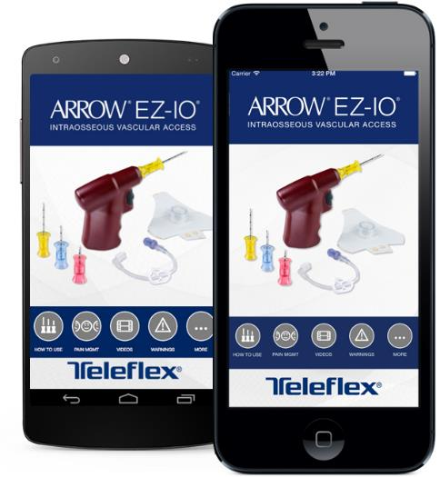
Resources
24 Hour Clinical Support 888-413-3104
Outside the US +1.800.680.4911
IO Infusion Pain Management

Slide 6
Disclaimer
This material is not intended to replace standard clinical education and training by Teleflex Incorporated, and should be utilized as an adjunct to more detailed information which is available about the proper use of the product. View educational resources at Teleflex.com or contact a Teleflex clinical professional with any detailed questions related to product insertion, maintenance, removal, and other clinical education information.
Rx Only.
CAUTION: Federal (USA) law restricts this device to sale by or on the order of a physician.
The Arrow® EZ-IO® Needle Set is Sterile, Single Use: Do not reuse, reprocess or re-sterilize. Reuse of device creates a potential risk of serious injury and/or infection which may lead to death. Refer to Instructions for Use for complete warnings, indications, contraindications, precautions, and potential complications.
Apple and the Apple logo are trademarks of Apple Inc., registered in the U.S. and other countries. Google Play is a trademark of Google Inc.
Teleflex, the Teleflex logo, Arrow, and EZ-IO are trademarks or registered trademarks of Teleflex Incorporated or its affiliates, in the U.S. and/or other countries. All other trademarks are trademarks of their respective owners.
© 2020 Teleflex Incorporated. All rights reserved. MC-000554rev3

